Slide 1

Penelitian Cloud Provisioning
Minute of Meeting
18 Juli 2022

Slide 2
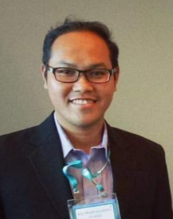
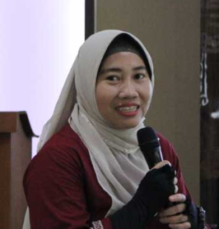

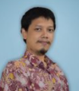

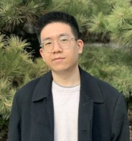
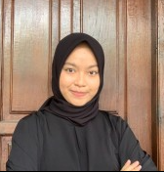
Anggota Tim
Dosen
mahasiswa
Ir. Ary Mazharuddin Shiddiqi, S.Kom., M.Comp.Sc., Ph.D (AM)
Dr. Diana Purwitasari, S.Kom., M.Sc. (DP)
Henning Titi Ciptaningtyas, S.Kom, M.Kom. (HC)
Ridho Rahman Hariadi, S.Kom., M.Sc. (RR)
Annisaa Sri Indrawanti, S. Kom., M. Kom (AS)
05311940000021 - Bryan Yehuda Mannuel (BY)
05311940000010 - Widya Inayatul Luthfiyah (WI)

Slide 3
Agenda Rapat
Pengenalan Anggota Tim
Jobdesc Anggota Tim
Latar Belakang
Target Penelitian
Timeline Kegiatan
Detil Penelitian – Algoritma
Detil Penelitian – Dataset
Detil Penelitian – Tools

Slide 4
Jobdesc
No | Kegiatan | PIC
1 | Konsep Penelitian | HC, AM, DP
2 | Implementasi GA-ANN | BY, disupervisi HC, RR
3 | Implementasi OBL-SSA | WI, disupervisi HC, RR
4 | Pengumpulan data ujicoba | BY, WI, HC, RR, AS
5 | Analisa dan penarikan kesimpulan | HC, disupervisi AM, DP
6 | Penulisan artikel jurnal | HC
7 | Reviewer artikel jurnal | AM, DP

Slide 5
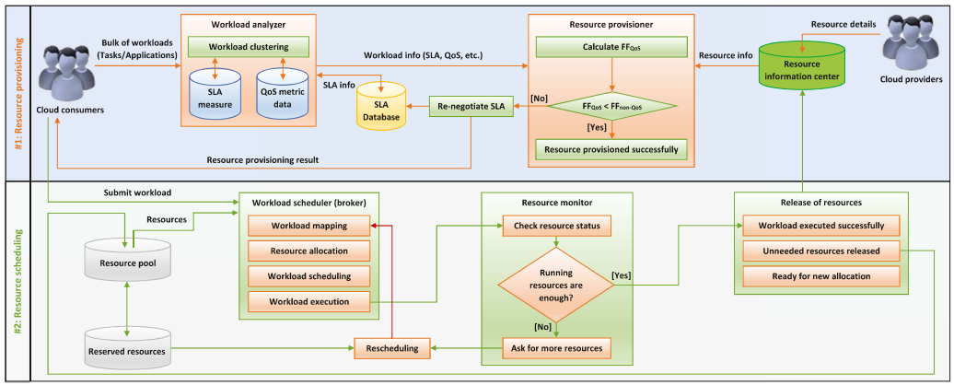
Latar Belakang

Slide 6
Target
IJIES (International Journal of Intelligent Engineering and Systems) journal
Submitted December 2022
So, aplikasi diharapkan selesai November awal.

Slide 7
Timeline Kegiatan Mahasiswa
Kegiatan | Minggu
 | 1 | 2 | 3 | 4 | 5 | 6 | 7 | 8 | 9 | 10 | 11 | 12
Pembuatan Proposal TA | √
Belajar cloudsim melalui tutorial online | √ | √
Pembuatan aplikasi GA - ANN OBL-SSA |  | √ | √ | √ | √ | √ | √ | √
Ujicoba aplikasi menggunakan dataset 1 dan 2 |  |  |  |  |  | √ | √ | √ | √
Analisa hasil uji coba |  |  |  |  |  |  |  | √ | √ | √
Penulisan laporan TA |  |  |  |  |  |  |  |  |  | √ | √ | √
Dimulai dari akhir Juli 2022

Slide 8
Detil Penelitian – Algoritma GA-ANN
Paper rujukan
→ GA original
→ GA-ANN

Slide 9
Detil Penelitian – Algoritma OBL-SSA
Paper rujukan
→ SSA original
→ OBL-SSA

Slide 10
Detil Penelitian – Dataset
Buatan
SDSC Horizon
VM:
3 types of VM
MIPS / proc: 400, 500, 600
RAM (MB): 512, 1024, 2048
Datacenter
6 Datacenter: D1 – D6
1,000,000 GB memory, 128 GB RAM
6 processsors, 3 host, 4 core
https://www.cs.huji.ac.il/labs/parallel/workload/l_sdsc_blue/index.html

Slide 11
Detil Penelitian – Data eksperimen yg dikumpulkan
Performance Metrics Average Start Time
Performance Metrics Average Finish Time
Performance Metrics Execution Time
Performance Metric Completed Tasks
Performance Metric Fault Rate

Slide 12
Detil Penelitian – Tools
Cloudsim – Link tutorial (15 jam)
https://www.udemy.com/course/learn-basics-of-cloudsim/learn/lecture/11495798?start=0#overview
Username: henning.its@gmail.com
Password: UdemyHenning
Eclipse

